Slide 1
Object Oriented Programming
Lecture 4

Slide 2
Introduction to Arrays
Primitive variables are designed to hold only one value at a time.
Arrays allow us to create a collection of like values that are indexed.
An array can store any type of data but only one type of data at a time.
An array is a list of data elements.

Slide 3
Creating Arrays
An array is an object so it needs an object reference.
// Declare a reference to an array that will hold integers.
int numbers[6];
Arrays may be of any type.
float temperatures[];
char letters[6];
long units[6];
double sizes[];
0
0
0
0
0
0
index 0
index 1
index 2
index 3
index 4
index 5
Array element values are initialized to 0. Array indexes always start at 0.

Slide 4
Creating Arrays
int myarr[3] = { 1, 5, 3}; // Create and initialize at the same time
OR
int myarr[3];
myarr[0] = 1;
myarr[1] = 5;
myarr[2] = 3;
1
5
3

Slide 5
Creating Arrays
The array size must be a non-negative number.
It may be a constant, or variable.
static int ARRAY_SIZE = 6;
int numbers[ARRAY_SIZE];
Once created, an array size is fixed and cannot be changed.

Slide 6
Accessing the Elements of an Array
20
0
0
0
0
0
numbers[0]
numbers[1]
numbers[2]
numbers[3]
numbers[4]
numbers[5]
An array is accessed by:
the reference name
a subscript that identifies which element in the array to access.
numbers[0] = 20; //pronounced "numbers sub zero"

Slide 7
Inputting and Outputting Array Elements
Array elements can be treated as any other variable.
They are simply accessed by the same name and a subscript.
Array subscripts can be accessed using variables (such as for loop counters).

Slide 8
Bounds Checking
Array indexes always start at zero and continue to (array size - 1).
int values [10];
This array would have indexes 0 through 9.
In for loops, it is typical to use i, j, and k as counting variables.
It might help to think of i as representing the word index.

Slide 9
Processing Array Contents
Processing data in an array is the same as any other variable.
grossPay = hours[3] * payRate;
Pre and post increment works the same:
int score[] = {7, 8, 9, 10, 11};
++score[2]; // Pre-increment operation
score[4]++; // Post-increment operation

Slide 10
Processing Array Contents
Array elements can be used in relational operations:
if(cost[20] < cost[0])
{
//statements
}
They can be used as loop conditions:
while(value[count] != 0)
{
//statements
}

Slide 11
Array Size
The length of an array can be obtained via its sizeof function
int size = sizeof(myarr)/ sizeof(myarr[0]);
cout<<size;

Slide 12
Passing Array Elements to a Method
When a single element of an array is passed to a method it is handled like any other variable.
More often you will want to write methods to process array data by passing the entire array, not just one element at a time.

Slide 13
Passing Arrays as Arguments
Arrays are objects.
Their references can be passed to methods like any other object reference variable.
showArray(numbers);
5
10
15
20
25
30
35
40
Address
void showArray(int array[])
{
for (int i = 0; i < sizeof(array); i++)
cout<< array[i]<< endl;
}

Slide 14
Comparing Arrays
The == operator determines only whether array references point to the same array object.
To compare the contents of an array:
int firstArray[] = { 2, 4, 6, 8, 10 };
int secondArray[]= { 2, 4, 6, 8, 10 };
boolean arraysEqual = true;
int i = 0;
if (firstArray.length != secondArray.length)
arraysEqual = false;
while (arraysEqual && i < firstArray.length)
{
if (firstArray[i] != secondArray[i])
arraysEqual = false;
i++;
}
if (arraysEqual)
System.out.println("The arrays are equal.");
else
System.out.println("The arrays are not equal.");

Slide 15
Useful Array Operations
Summing Array Elements:
int total = 0; // Initialize accumulator
for (int i = 0; i < units.length; i++)
total += units[i];
Averaging Array Elements:
double total = 0; // Initialize accumulator
double average; // Will hold the average
for (int i = 0; i < scores.length; i++)
total += scores[i];
average = total / scores.length;

Slide 16
Returning an Array Reference
C++ does not allow to return an entire array as an argument to a function. However, you can return a pointer to an array by specifying the array's name without an index
int* getArray()
{
int array[] = { 2,3,4 };
return array;
}

Slide 17
Dynamic Arrays
int* dyArray = new int[8];
for (int i = 0; i<8; i++)
{ dyArray[i] = i;
cout<<dyArray[i]<<endl;
}
delete[] dyArray;
cout<<"\nSize of intarray is "<<sizeof(intarray); cout<<"\nSize of single element of intarray is "<<sizeof(intarray[0]);

Slide 18
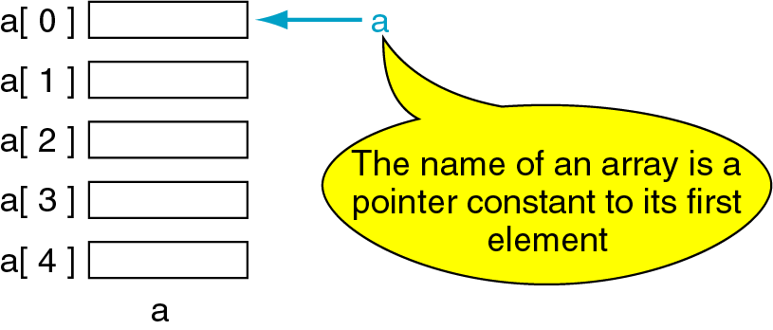
Pointers and Arrays
The name of an array points only to the first element not the whole array.
1000
1004
1008
1012
1016

Slide 19
Array Name is a pointer constant
#include <iostream>
using namespace std;
void main (){
int a[5];
cout << "Address of a[0]: " << &a[0] << endl
<< "Name as pointer: " << a << endl;
}
Result:
Address of a[0]: 0x0065FDE4
Name as pointer: 0x0065FDE4

Slide 20
Dereferencing An Array Name
This element is called a[0] or *a
#include <iostream>
using namespace std;
void main(){
int a[5] = {2,4,6,8,22};
cout << *a << " "
<< a[0];
} //main
a[0]
2
a
a[1]
4
a[2]
6
a[3]
8
a[4]
22
a

Slide 21

Array Names as Pointers
To access an array, any pointer to the first element can be used instead of the name of the array.
We could replace *p by *a
#include <iostream>
using namespace std;
void main(){
int a[5] = {2,4,6,8,22};
int *p = a;
cout << a[0] << " "
<< *p;
}
a
p
a[0]
2
2 2
a[1]
4
a[2]
6
a[3]
8
a[4]
22
a

Slide 22
Multiple Array Pointers
Both a and p are pointers to the same array.
#include <iostream>
using namespace std;
void main(){
int a[5] = {2,4,6,8,22};
int *p = &a[1];
cout << a[0] << " "
<< p[-1];
cout << a[1] << " "
<< p[0];
}
a[0]
a[0]
2 2
4 4
2
p
a[1]
4
a[2]
6
p[0]
a[3]
8
a[4]
22

Slide 23
Pointer Arithmetic
Given a pointer p, p+n refers to the element that is offset from p by n positions.
a
2
p - 1
4
p
a + 1
a + 2
6
p + 1
a + 3
8
p + 2
a + 4
22
p + 3

Slide 24
Dereferencing Array Pointers
a[0] or *(a + 0)
2
a
a[1] or *(a + 1)
4
a + 1
a[2] or *(a + 2)
6
a + 2
a[3] or *(a + 3)
8
a + 3
a[4] or *(a + 4)
22
a + 4
*(a+n) is identical to a[n]
Note: flexible pointer syntax

